Slide 1


Telegram Bot for Human Rights
Human rights are fundamental rights inherent to all human beings, regardless of race, sex, nationality, ethnicity, language, religion, or any other status. They are universal, inalienable, and indivisible.
Telegram is an increasingly popular messaging app for human rights organizations. Bots offer new opportunities to engage audiences and enhance advocacy efforts.
LAKSHMI SAHITHI KONDAPALLI

Slide 2


The Universal Declaration of Human Rights
The Universal Declaration of Human Rights (UDHR) is a milestone document that proclaims the fundamental rights and freedoms to which all humans are entitled. It was adopted by the United Nations General Assembly in 1948.
1
Fundamental Rights
2
Equal Rights
The UDHR outlines basic human rights, including the right to life, liberty, and security of person; freedom from slavery and torture; and the right to a fair trial.
It asserts that all human beings are born free and equal in dignity and rights, and that everyone is entitled to all the rights and freedoms set forth in the Declaration.
3
Universal Principles
4
Foundation for International Law
The UDHR is a universal document that applies to everyone, regardless of their nationality, race, gender, sexual orientation, religion, or any other status.
The UDHR has served as the foundation for many other international human rights instruments, such as the International Covenant on Civil and Political Rights and the International Covenant on Economic, Social and Cultural Rights.

Slide 3

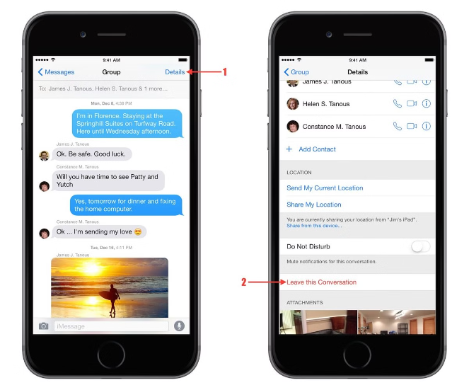
Importance of Telegram for Human Rights Advocacy
Telegram provides a secure platform for communication, protecting sensitive information from censorship and surveillance. Its large user base and global reach make it an ideal tool for reaching diverse audiences.
1
Accessibility
2
Security
Telegram is accessible worldwide, allowing organizations to connect with individuals in remote areas.
Telegram offers end-to-end encryption, ensuring privacy and confidentiality.
3
Engagement
4
Scalability
Bots allow for interactive communication and personalized content delivery, fostering user engagement.
Bots can handle large volumes of messages, making them efficient for reaching diverse audiences.

Slide 4


Use Cases of Telegram Bot in Human Rights Activism
Human rights organizations are using bots for a variety of purposes, from providing information and resources to organizing campaigns and mobilizing supporters.
Bot can share news updates, reports, and resources related to human rights issues.
Bot can be used to gather signatures, spread awareness, and organize protests.
Bot can provide support and guidance to individuals facing human rights violations.
Bot can connect individuals with legal resources and provide information about their rights.

Slide 5
THANK YOU
LAKSHMI SAHITHI KONDAPALLI
PHONE:9347741025
MAIL : LAKSHMISAHITHI2003@GMAIL.COM

